Slide 1
Chapter 5
Some Discrete Probability Distributions

Slide 2
Section 5.1
Introduction and Motivation

Slide 3
Section 5.2
Binomial and Multinomial Distributions

Slide 4
Theorem 5.1

Slide 5
Section 5.3
Hypergeometric Distribution

Slide 6
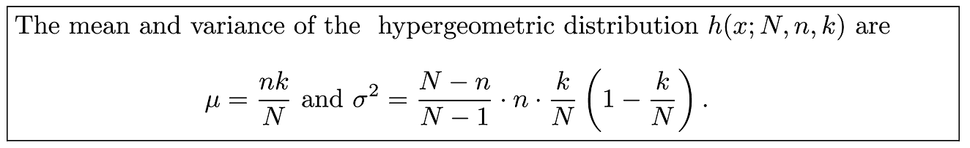
Theorem 5.2

Slide 7
Section 5.4
Negative Binomial and Geometric Distributions

Slide 8
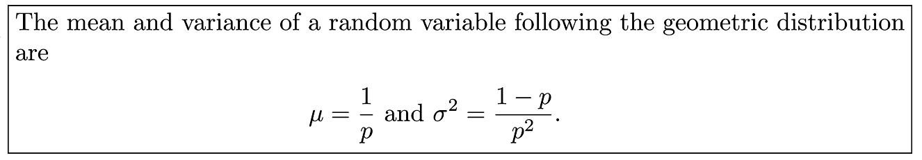
Theorem 5.3

Slide 9
Section 5.5
Poisson Distribution and the Poisson Process

Slide 10
Theorem 5.4

Slide 11
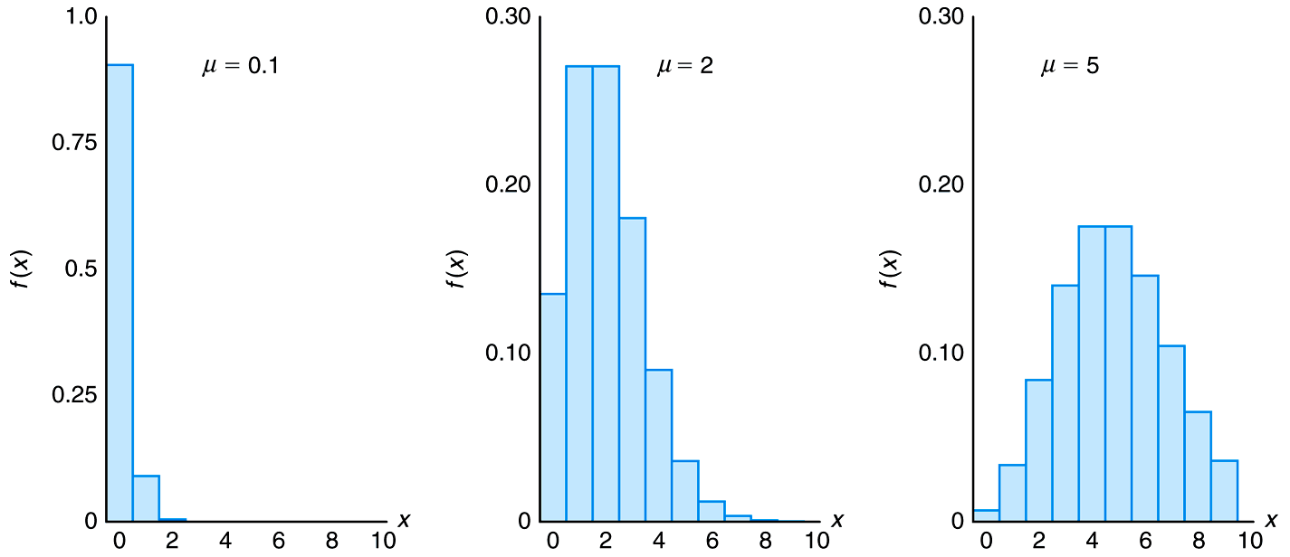
Figure 5.1 Poisson density functions for different means

Slide 12
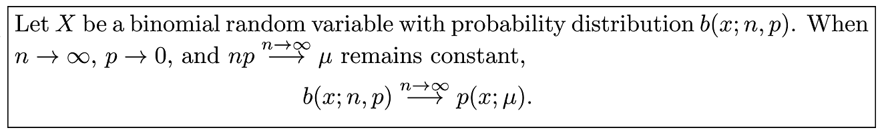
Theorem 5.5

Slide 13
Section 5.5
Potential Misconceptions and Hazards; Relationship to Material in Other Chapters

